Slide 1

Travel Insurance Prediction
Dokumen Laporan Final Project Raka-Max

Slide 2
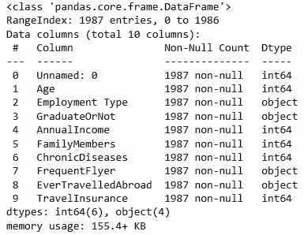
Data Cleansing (info + duplicate)
Tidak ada missing value

Slide 3
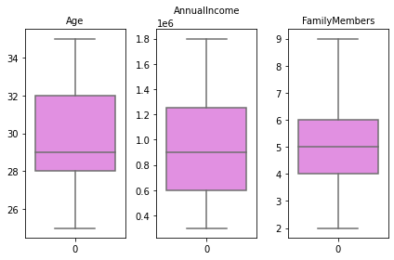
Data Cleansing (Handle Outliers)
No outliers

Slide 4
Data Cleansing (feature transformation + encoding)

Slide 5
Data Cleansing (Class Imbalance)

Slide 6
Feature Engineering

